Slide 1
BADM 554 - Project Presentation
Group 9 - Abdullah Khan, Amelia Knight, Wade Herrera, and Yujing Wang

Slide 2

Project 1 – Data-Driven Restaurant Planning Using Yelp
Yelp Data Analysis
Our goal was to use Yelp data to identify optimal strategies for launching a new restaurant.
By writing SQL queries on a structured version of the Yelp dataset, we explored customer behavior, competitive hotspots, pricing patterns, and service preferences — all to make data-driven business decisions.

Slide 3

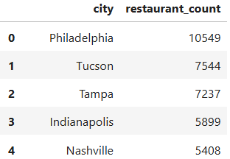
Choosing the Right City – Why Nashville?
We analyzed cities with the highest number of restaurants on Yelp
Nashville ranked in the top 5 — indicating a strong, active food scene
High restaurant count = competitive, but also full of opportunity
Its blend of southern charm and a rising dining culture made it ideal for deeper analysis

Slide 4
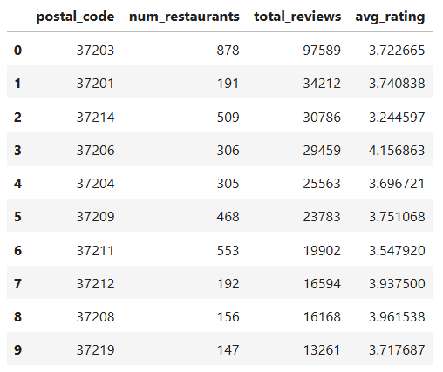
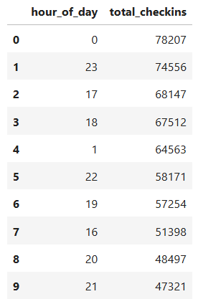
Targeting the Right Area & Time
🕒 Customer Traffic Patterns by Hour
🧠 Insight:
We found that the busiest check-in times in Nashville occur around midnight, 11 PM, and during traditional dinner hours (5–7 PM).
This suggests strong customer demand in both early evening and late-night slots.
📌 What We’ll Do:
We plan to extend operating hours to at least midnight to capture the late-night crowd.
We’ll also introduce a 5–7 PM happy hour to attract the after-work and early dinner segment — effectively serving two high-demand customer groups.
📍 Location Performance by Zip Code
📌 What We’ll Do:
We’ll consider 37203 for exposure and customer volume, or 37206 for a more premium, reputation-driven launch — depending on our brand positioning.

Slide 5
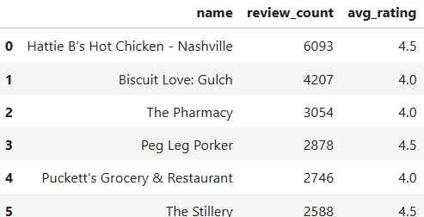
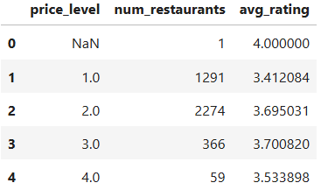
What Nashville’s Best Restaurants Teach Us
💵 Average Rating by Price Level
🧠 Insight: Mid-priced restaurants (levels 2–3) in Nashville earn higher ratings (~3.7) than low or premium-priced spots, showing that customers value quality over the cheapest option.
📌 What We’ll Do: We’ll position our restaurant in the mid-range segment to balance quality with value perception.
🍗 Learning from Local Favorites
🧠 Insight: Top-reviewed spots like Hattie B’s and Biscuit Love succeed with strong branding and regional comfort food that consistently earns ratings above 4.0.
📌 What We’ll Do: We’ll draw inspiration from their strengths while offering a modern or fusion twist to stand out and attract adventurous diners.

Slide 6



“Takeout vs Delivery: Choosing the Right Model”
🛍️ Takeout vs Delivery Insight
🧠 Insight: Only 30% of Nashville restaurants offer delivery, while 50% offer takeout — suggesting that takeout is more widely adopted and lower-risk.
📌 Action: We’ll start with a takeout-first model to test demand before scaling to delivery.

Slide 7

Turning Insights Into Action
🚀 Our Strategy Going Forward:
Location-first approach: Prioritize visibility in ZIP 37203 or reputation in ZIP 37206
Dinner-focused hours with optional late-night service
Mid-range price point to balance quality and reach
Explore niche cuisine with strong branding
Launch with takeout, expand to delivery later

Slide 8

Key Skills Developed
Advanced SQL Skills: Used joins, filters, CAST, GROUP BY, and nested queries to extract insights from complex Yelp data
Azure SQL & Schema Design: Converted JSON data into structured SQL tables with proper keys and constraints on Azure
Data Cleaning & Transformation: Handled semi-structured data, dealt with missing values, and standardized formats for analysis
Insight Generation: Translated raw data into actionable restaurant strategy — location, timing, pricing, and service model
Business Communication: Presented technical results in a clear, narrative format tailored to decision-makers

Slide 9
Project 2 – How can I maximize my salary and accelerate my career in today’s job market?
Salary Optimization through Skills, Seniority, and Remote Work Analysis
Our goal was to use data-analyst-job-postings-google-search data to uncover the most effective strategies for maximizing salary and career progression as a Data Analyst.
By writing SQL queries on a structured dataset of analyst job postings, we examined the impact of technical skills, experience level, and remote work options on compensation.

Slide 10

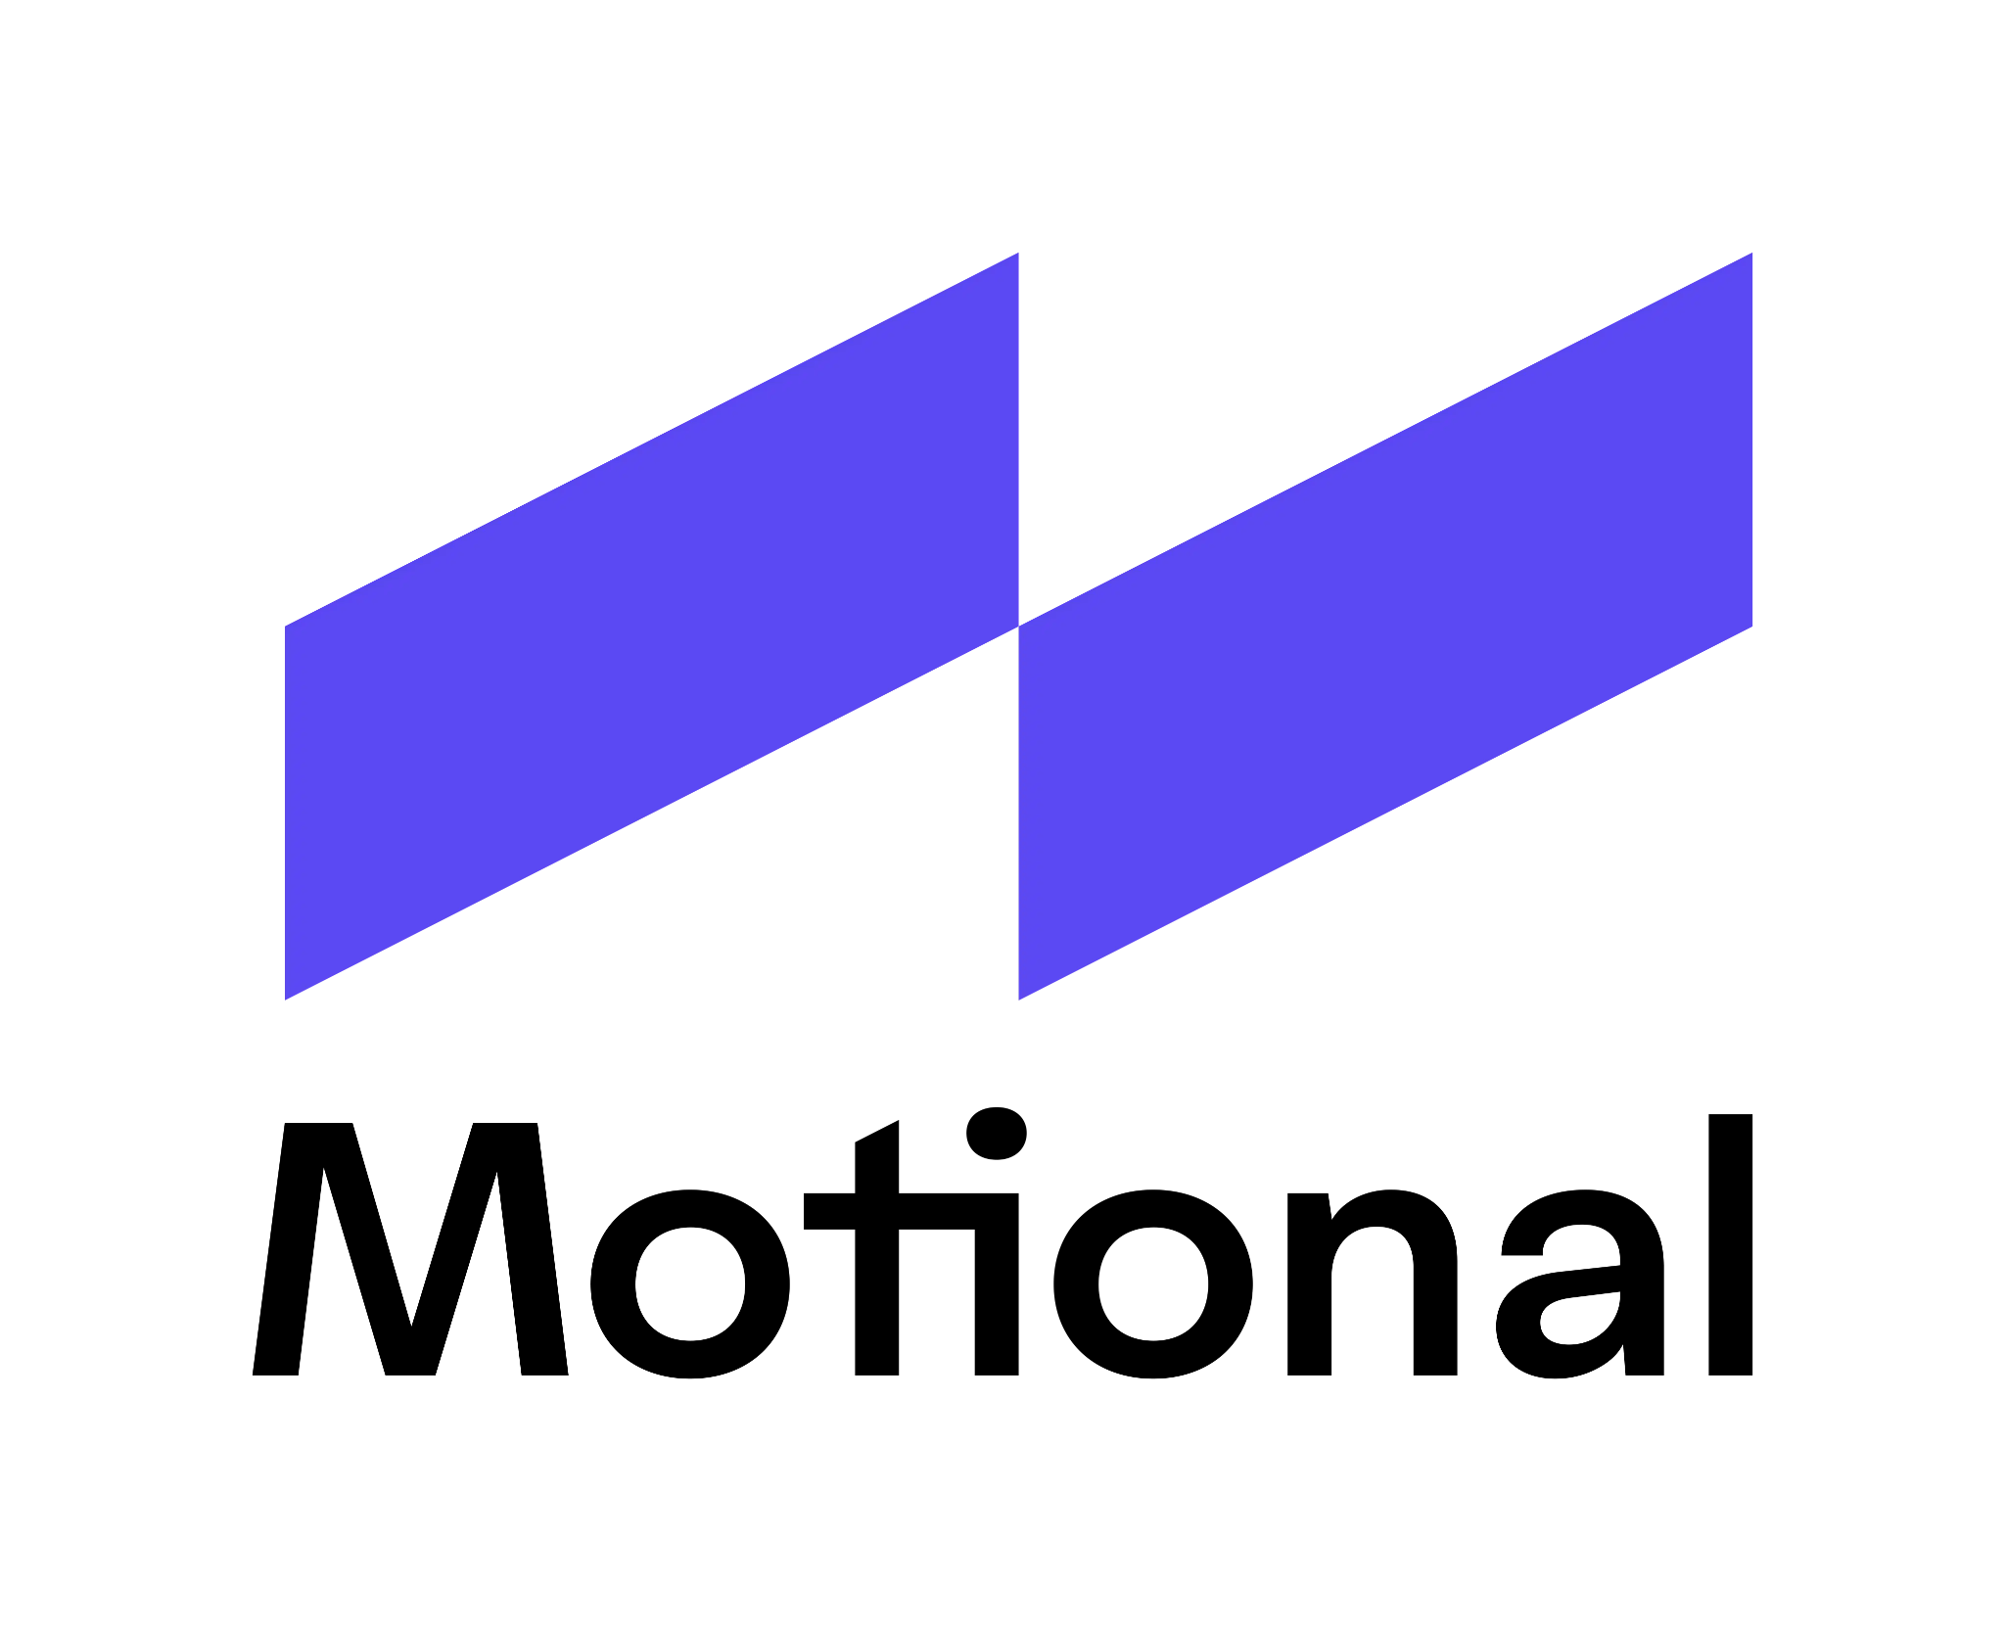

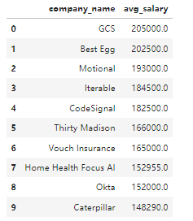
Who’s paying top dollar for remote data analysts?
Remote tech companies offer top compensation
Intent: Identify companies offering the highest average salaries for remote Data Analyst roles.
Output: Firms like GCS, Best Egg offered salaries well above the norm (some >$150K).
Relevance: Helps job seekers prioritize remote employers in high-paying sectors like fintech and AI.
Insight: Remote jobs in tech sectors are highly lucrative; targeting these can boost earnings significantly.

Slide 11
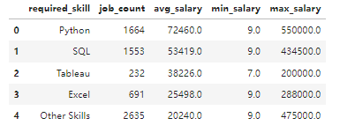
What skills those jobs require?
Learn to code or get left behind.
Intent: Analyze how specific tools (Python, SQL, Tableau, Excel) influence salary.
Output: Python commands the highest average salary ($72K), while Excel lags far behind ($25K).
Relevance: Guides skill development and certification decisions for job seekers.
Insight: Advanced technical skills, especially in Python, directly correlate with higher compensation.

Slide 12
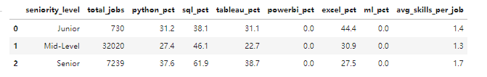
How do skill expectations change as you move up?
If you want to get promoted, your technical stack has to level up too
Intent: Assess how required skills shift across Junior, Mid, and Senior Data Analyst roles.
Output: SQL demand rises from 38.1% (Junior) to 61.9% (Senior); Python from 31.2% to 37.6%.
Relevance: Helps professionals map career growth with needed skill evolution.
Insight: SQL remains the cornerstone at all levels; Excel fades with advancement.

Slide 13
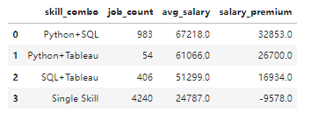
What happens if I combine high-value skills?
It’s not just about one skill—it’s about the right combination.
Intent: Quantify salary benefits of combining skills (e.g., Python + SQL vs. single skills).
Output: Python+SQL pays $67K (vs. $24K single-skill jobs), with a $32K premium over the market average.
Relevance: Proves the value of bundling high-demand skills for salary boosts.
Insight: Composite skills dominate salary leaders; upskilling is financially strategic.

Slide 14
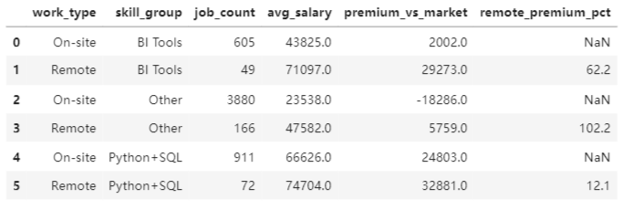
Does working remotely affect the skill premium?
Remote work isn’t just flexible—it’s profitable.
Intent: Determine how remote status amplifies salary based on skill set.
Output: Python+SQL remote roles pay 12% more than onsite; BI tools have a 62% remote premium.
Relevance: Informs work arrangement preferences (remote vs onsite).
Insight: Remote roles offer outsized salary premiums—especially for visualization skill sets.

Slide 15

Turning Insights Into Action
Best Path
Master Python + SQL+BI
↓
Advance to Senior Level
↓
Find Remote Positions
↓
Maximize High Salary (>$150K)

Slide 16
Key Skills Developed
Advanced SQL Techniques: Used CASE, CTE, GROUP BY, JOIN, and window functions like LAG() to calculate salary premiums, skill demand trends, and market benchmarks.
Data Modeling & Structuring: Designed multi-step SQL logic using common table expressions to organize job listing data by skill, seniority, and work format.
Statistical Insight Extraction: Calculated averages, salary differentials, and percentage premiums to evaluate how technical skills and remote work affect compensation.
Career Strategy Framing: Translated raw job post data into practical insights for career decision-making — including skill combinations, promotion paths, and remote advantages.

Slide 17
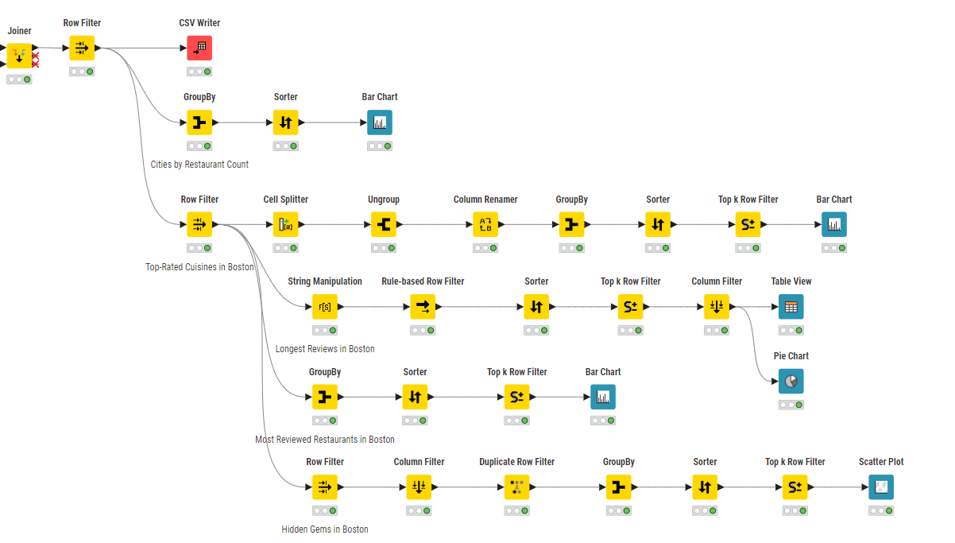
Mini Project #3 Part 1
What are the popular and underrated high-potential restaurants in Boston?

Slide 18
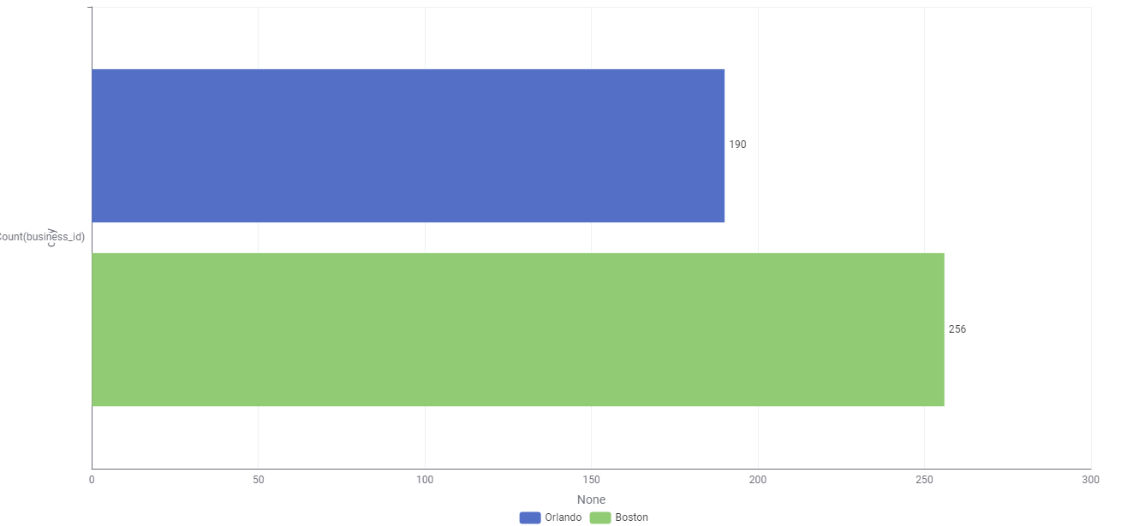
Where Are Restaurants Concentrated in？
Objective: Identify cities with the highest number of restaurants.
Insight: Boston is among the top cities with the highest restaurant concentration(#256), indicating a mature and competitive market.

Slide 19
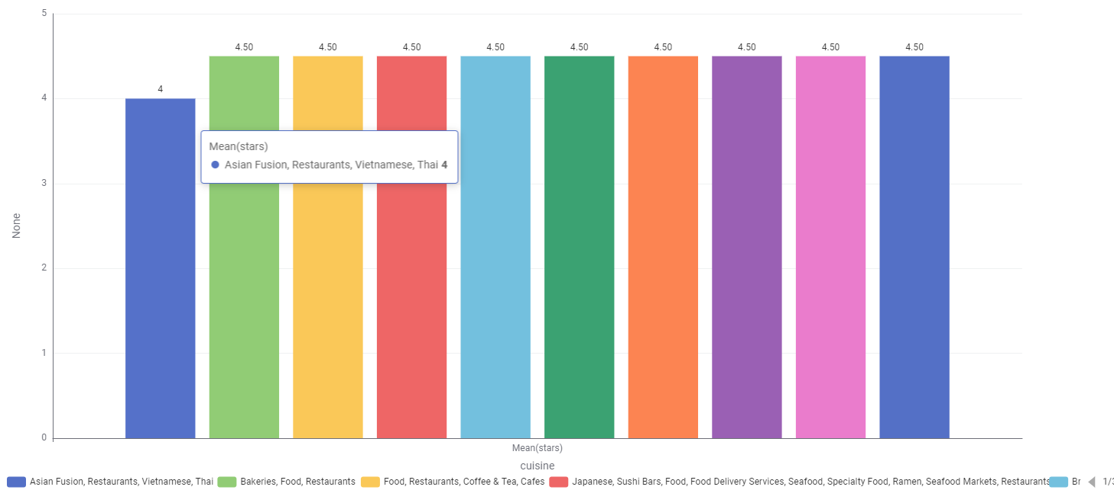
What Types of Restaurants Are Most Loved in Boston?
Objective: Determine the most highly rated(>=4 stars) restaurant categories.
Insight: Cuisines like Japanese, Mediterranean, and Thai are among the top-rated, reflecting consumer taste trends.

Slide 20
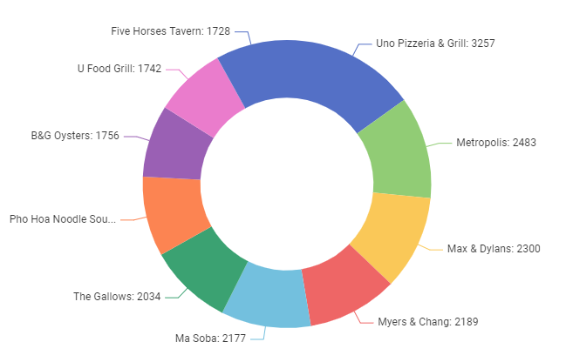
Which Restaurants Inspire the Most Detailed Reviews?
Objective: Find restaurants that receive long, thoughtful reviews.
Insight: Long reviews signal emotional engagement; these restaurants may offer memorable experiences, like Uno Pizzeria & Grill.

Slide 21
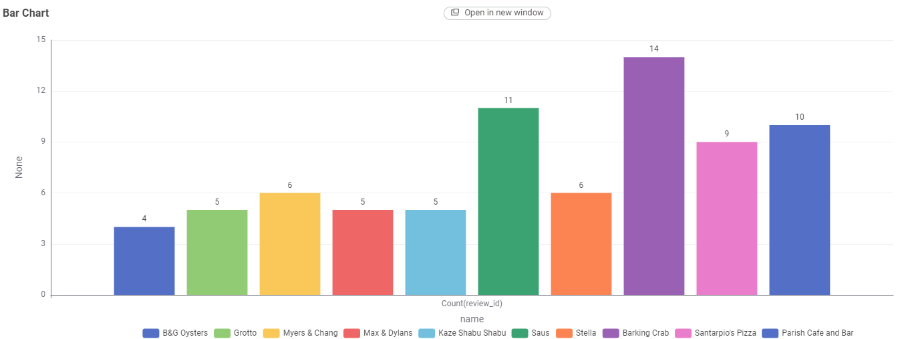
Who Are the Crowd Favorites?
Objective: Identify Boston restaurants with the most reviews.
Insight: These are the most visited and discussed places—potential leaders in the local food scene, especially the Barking Crab.

Slide 22
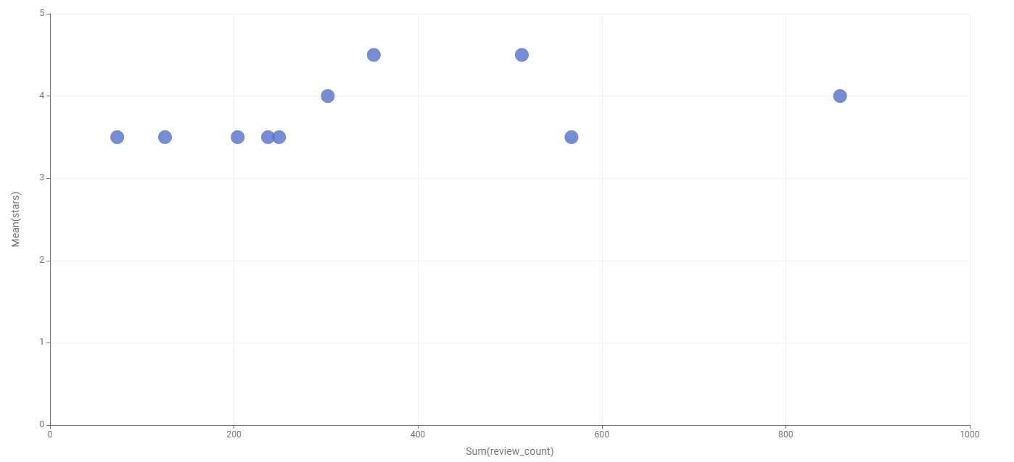
Which High-Rated Restaurants Are Flying Under the Radar?
Objective: Discover lesser-known restaurants with high ratings.
Insight: These are "hidden gems" with great potential for growth or marketing. Zo Greek have the high ratings(4.5) but not too much reviews(#352)

Slide 23
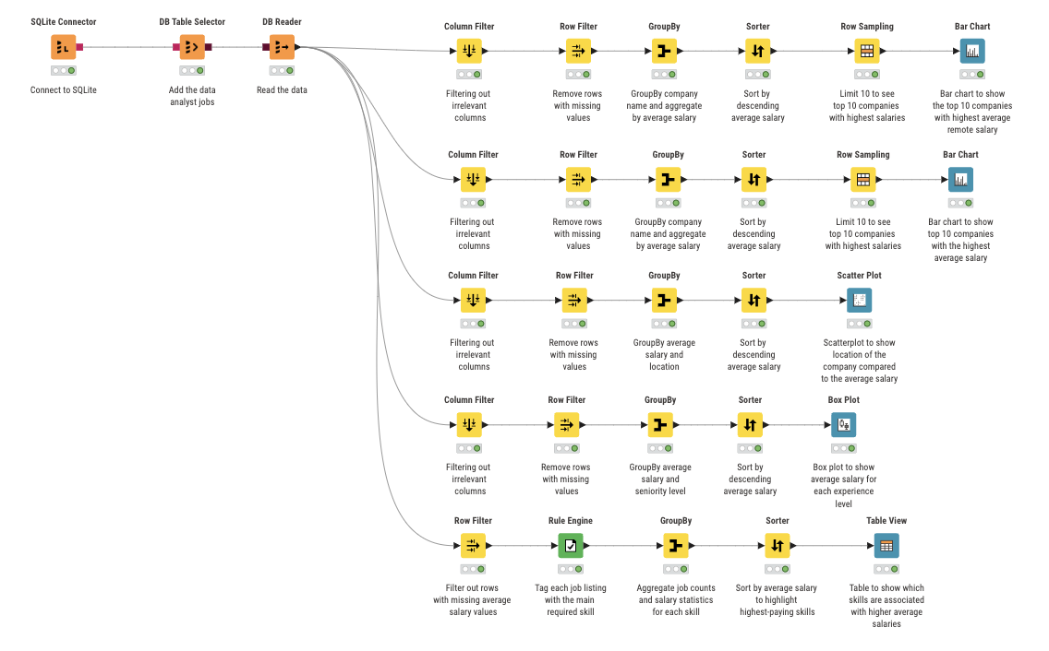
Mini Project #3 Part 2
What factors contribute to higher average salaries for data analyst roles across different companies, experience and locations?

Slide 24
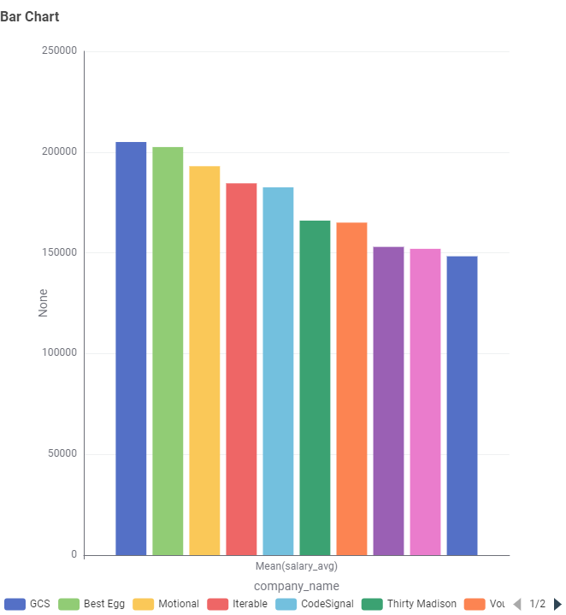
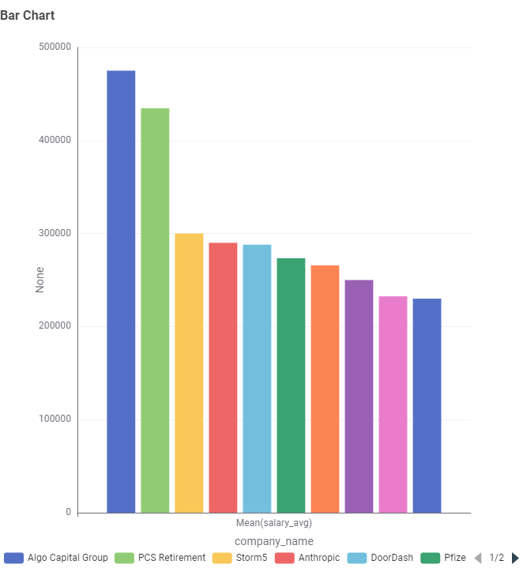
What companies have the highest average salaries for remote and non-remote positions?
Objective: To analyze and compare companies offering the highest average salaries for data analysts in both remote and overall.
Insight: Companies offering remote salaries change from the companies offering the highest overall salaries.
Highest Average Remote Salary
Highest Average Salary

Slide 25
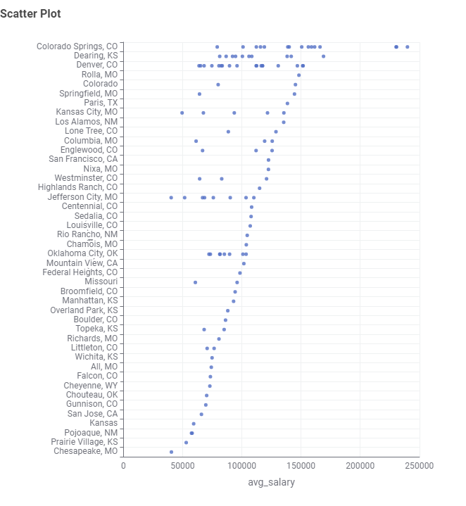
Average Salary By Location
Objective: To visualize how average data analyst salaries vary across different U.S. cities helping identify geographic trends and outliers in compensation.
Insight: Geographic trends can help job seekers target higher-paying markets based on where salaries tend to be higher.

Slide 26
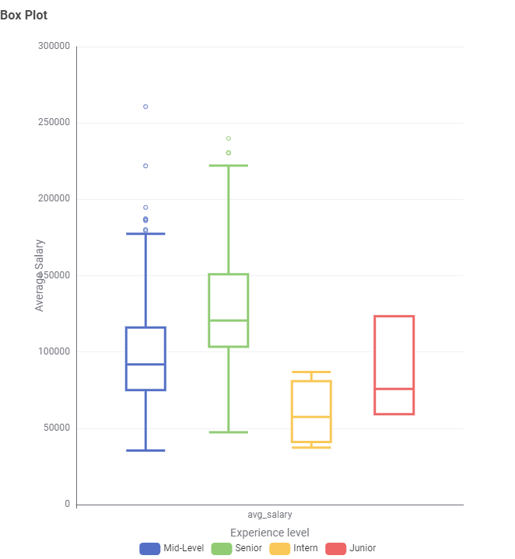
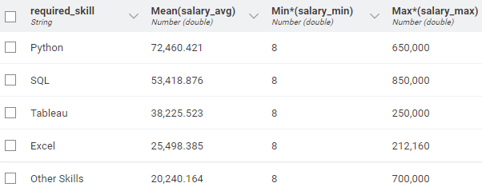
Average Salary by Experience Level and Skills
Objective: To show how salary varies across experience levels and show which technical skills pay the most in the data analytics job market.
Insight: The skills table reveals that Python and SQL are linked to significantly higher average salaries, while tools like Excel and Tableau command lower averages. While the box plot shows that senior-level roles offer the highest median salaries and have the widest salary range.

Slide 27
Team Reflection and Takeaways
Abdullah: One of the more challenging aspects for me was handling large volumes of data and converting semi-structured formats into a usable structure. The most rewarding part, however, was being able to extract meaningful business insights from it.
Amelia: One of the most challenging parts was making sure that each query, workflow and visualization was driven by clear intent and aligned with a specific analytical purpose.
Wade: One of the most challenging parts on the projects was learning how to properly clean and manipulate messy or inconsistent data. The most rewarding part was once the data was cleaned and structured was getting to see the clear visual insights from them.
Yujing: One of the most challenging parts was ensuring the clean,consistent logic when writing complex SQL queries (especially the CTEs and CASE statements). One of the rewarding parts was seeing how raw data can be transformed into business insights.

Slide 28
Thank You!

